Slide 1

Azure Cognitive Services

Slide 2
What are Azure Cognitive Services?
https://docs.microsoft.com/en-us/azure/cognitive-services/welcome

Slide 3
What are Azure Cognitive Services?
• "The goal of Azure Cognitive Services is to help developers create applications that can see, hear, speak, understand, and even begin to reason."
• "The catalog of services within Azure Cognitive Services can be categorized into five main pillars - Vision, Speech, Language, Web Search, and Decision."
https://docs.microsoft.com/en-us/azure/cognitive-services/welcome

Slide 4
Vision APIs
• Computer Vision
• Custom Vision Service
• Face API
• Form Recognizer (Preview)
• Ink Recognizer (Preview)
• Video Indexer
https://docs.microsoft.com/en-us/azure/cognitive-services/welcome#vision-apis
Notes:
Computer Vision
The Computer Vision service provides you with access to advanced algorithms for processing images and returning information.
Custom Vision Service
The Custom Vision Service allows you to build custom image classifiers.
Face API
Face API provides access to advanced face algorithms, enabling face attribute detection and recognition.
Form Recognizer (Preview)
Form Recognizer identifies and extracts key-value pairs and table data from form documents; then outputs structured data including the relationships in the original file.
Ink Recognizer (Preview)
Ink Recognizer allows you to recognize and analyze digital ink stroke data, shapes and handwritten content, and output a document structure with all recognized entities.
Video Indexer
Video Indexer enables you to extract insights from your video.

Slide 5
Speech APIs
• Speech Services
• Speaker Recongition API (Preview)
• Bing Speech (Retiring)
• Translator Speech (Retiring)
https://docs.microsoft.com/en-us/azure/cognitive-services/welcome#speech-apis
Notes:
Speech Services
Speech Service adds speech-enabled features to applications.
Speaker Recognition API (Preview)
The Speaker Recognition API provides algorithms for speaker identification and verification.
Bing Speech (Retiring)
The Bing Speech API provides you with an easy way to create speech-enabled features in your applications.
Translator Speech (Retiring)
Translator Speech is a machine translation service.

Slide 6
Language APIs
• Language Understanding Service (LUIS)
• QnA Maker
• Text Analytics
• Translator Text
https://docs.microsoft.com/en-us/azure/cognitive-services/welcome#language-apis
Notes:
Language Understanding LUIS
Language Understanding service (LUIS) allows your application to understand what a person wants in their own words.
QnA Maker
QnA Maker allows you to build a question and answer service from your semi-structured content.
Text Analytics
Text Analytics provides natural language processing over raw text for sentiment analysis, key phrase extraction and language detection.
Translator Text
Translator text provides for machine-based text translation in near real-time.
Video Indexer
Video Indexer enables you to extract insights from your video.

Slide 7
Search APIs
• Bing News Search
• Bing Video Search
• Bing Web Search
• Bing Autosuggest
• Bing Custom Search
• Bing Image Search
• Bing Visual Search
• Bing Spell Check
https://docs.microsoft.com/en-us/azure/cognitive-services/welcome#search-apis
Notes:
Bing News Search
Bing News Search returns a list of news articles determined to be relevant to the user's query.
Bing Video Search
Bing Video Search returns a list of videos determined to be relevant to the user's query.
Bing Web Search
Bing Web Search returns a list of search results determined to be relevant to the user's query.
Bing Autosuggest
Bing Autosuggest allows you to send a partial search query term to Bing and get back a list of suggested queries.
Bing Custom Search
Bing Custom Search allows you to create tailored search experiences for topics that you care about.
Bing Entity Search
Bing Entity Search returns information about entities that Bing determines are relevant to a user's query.
Bing Image Search
Bing Image Search returns a display of images determined to be relevant to the user's query.
Bing Visual Search
Bing Visual Search provides returns insights about an image such as visually similar images, shopping sources for products found in the image, and related searches.
Bing Local Business Search
Bing Local Business Search API enables your applications to find contact and location information about local businesses based on search queries.
Bing Spell Check
Bing Spell Check allows you to perform contextual grammar and spell checking.

Slide 8
Decision APIs
• Anomaly Detector (Preview)
• Content Moderator
• Personalizer (Preview)
https://docs.microsoft.com/en-us/azure/cognitive-services/welcome#decision-apis
Notes:
Anomaly Detector (Preview)
Anomaly Detector allows you to monitor and detect abnormalities in your time series data.
Content Moderator
Content Moderator provides monitoring for possible offensive, undesirable, and risky content.
Personalizer (Preview)
Personalizer allows you to choose the best experience to show to your users, learning from their real-time behavior.

Slide 9
Accessing these APIs
• Try them for free
Or
• Access via:
a free Azure Subscription
a paid Azure Subscription
https://azure.microsoft.com/en-us/try/cognitive-services/
Notes:
Caveat around the free services:
Typically they allow between 5,000 to 30,000 transactions per month and limited to only 20 per minute.
For free subscription, once the USD$200 credit is used up, only the Face API is free to continue using
Pricing though on paid subscription is generally low
e.g. for vision
0-1M transactions — $1.512 per 1,000 transactions
1M-5M transactions — $1.210 per 1,000 transactions
5M-10M transactions — $0.983 per 1,000 transactions
10M-100M transactions — $0.983 per 1,000 transactions
100M+ transactions — $0.983 per 1,000 transactions
Speech and Search around 8 – 10 NZD per 1,000 transactions

Slide 10
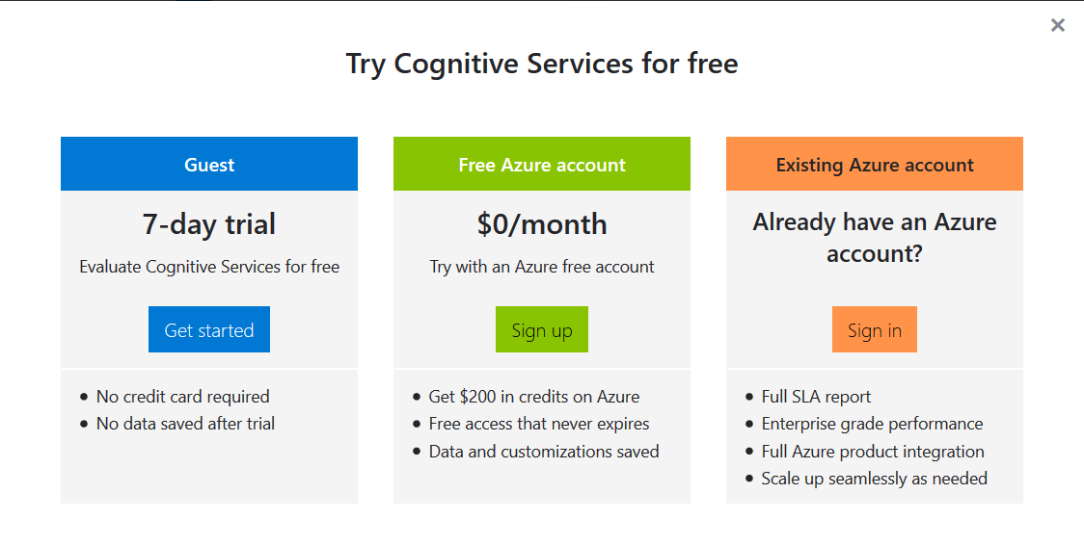
Accessing these APIs
https://azure.microsoft.com/en-us/try/cognitive-services/

Slide 11
Who uses Cognitive Services
Volpara Solutions – use Custom Vision Service to assist in cancer detection in mammograms
FujiFilm – use Computer Vision to automatically tag players from NPB game photos
Tech Mahindra – created a digital office assistant
AnalogFolk – UK marketing agency used facial recognition to detect marmite taste gene.
https://azure.microsoft.com/en-in/case-studies/?service=cognitive-services
Notes:
1. Volpara has their head office in NZ
2. the Nippon Professional Baseball Organization (NPB) adopted the solution to centrally manage game photos
3. Office assitant can book leave, book travel and lodge expense claims. Also a machine learning algorithm is used to identify the calls using team notes and other cues. It then routes the calls to the relevant teams and thereby eliminates any human intervention.
4. The apps invite people to try Marmite in front of the App, which then uses facial recognition technology to analyse their reaction to it. The software builds on the Microsoft Emotion API that recognises facial expressions across eight emotions such as happiness, disgust, contempt, surprise and fear.

Slide 12
Demo

Slide 13
• Configuring Cognitive Services Endpoint in Azure • Microsoft Documentation • Calling Cognitive Services via Postman • Calling Cognitive Services via VS Code

Slide 14
Useful Links

Slide 15
Documentation: • https://docs.microsoft.com/en-us/azure/cognitive-services/ • https://westus.dev.cognitive.microsoft.com/docs/services/ Try Cognitive Services: • https://azure.microsoft.com/en-us/try/cognitive-services/ Sample Code:
• https://github.com/mikehowell/Cognitive-Services-Demo

